Slide 1
Final Project of Applied Data Science Capstone - Find a new living area in Toronto
Coursera - Applied Data Science Capstone
Capstone Project - The Battle of Neighborhoods
2021.05.05
Chien-Hsi Chen

Slide 2
Content
Introduction
Data for this project
Methods
Results
Discussion and Conclusion

Slide 3
Introduction
Many purposes to move, new job, study, retirement
Moving is hard, especially to a strange place or foreign countries
Information of the place to move is everywhere but also nowhere
Quality of life (QoL) is the key to decide where to live
Many factors
A quick and thorough way to gather information to help decide where would be a suitable residential area is required

Slide 4
Scenario for this project
David, a software engineer
Home office and only sometimes to the office for meetings.
The distance between his home and office is not important
The quality of life is the thing he cares the most
Requirements for the new home
Restaurants right down the street within 200 meters
Fresh coffee from the coffee shops
Work out in a gym after the long working time
Avoid any areas that may cause allergies, such as parks, flower stores, pet stores, or something similar

Slide 5
Data for this project
Borough data of Toronto from Wikipedia
Location data from Foursquare

Slide 6
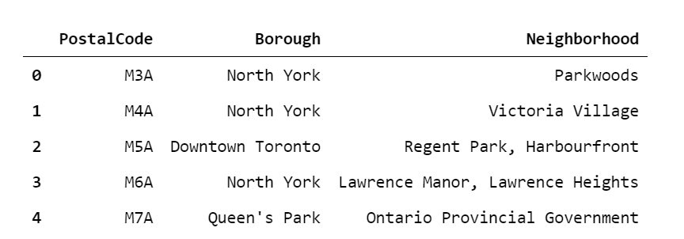
Methods
Retrieve necessary location data from Wiki and Foursquare

Slide 7
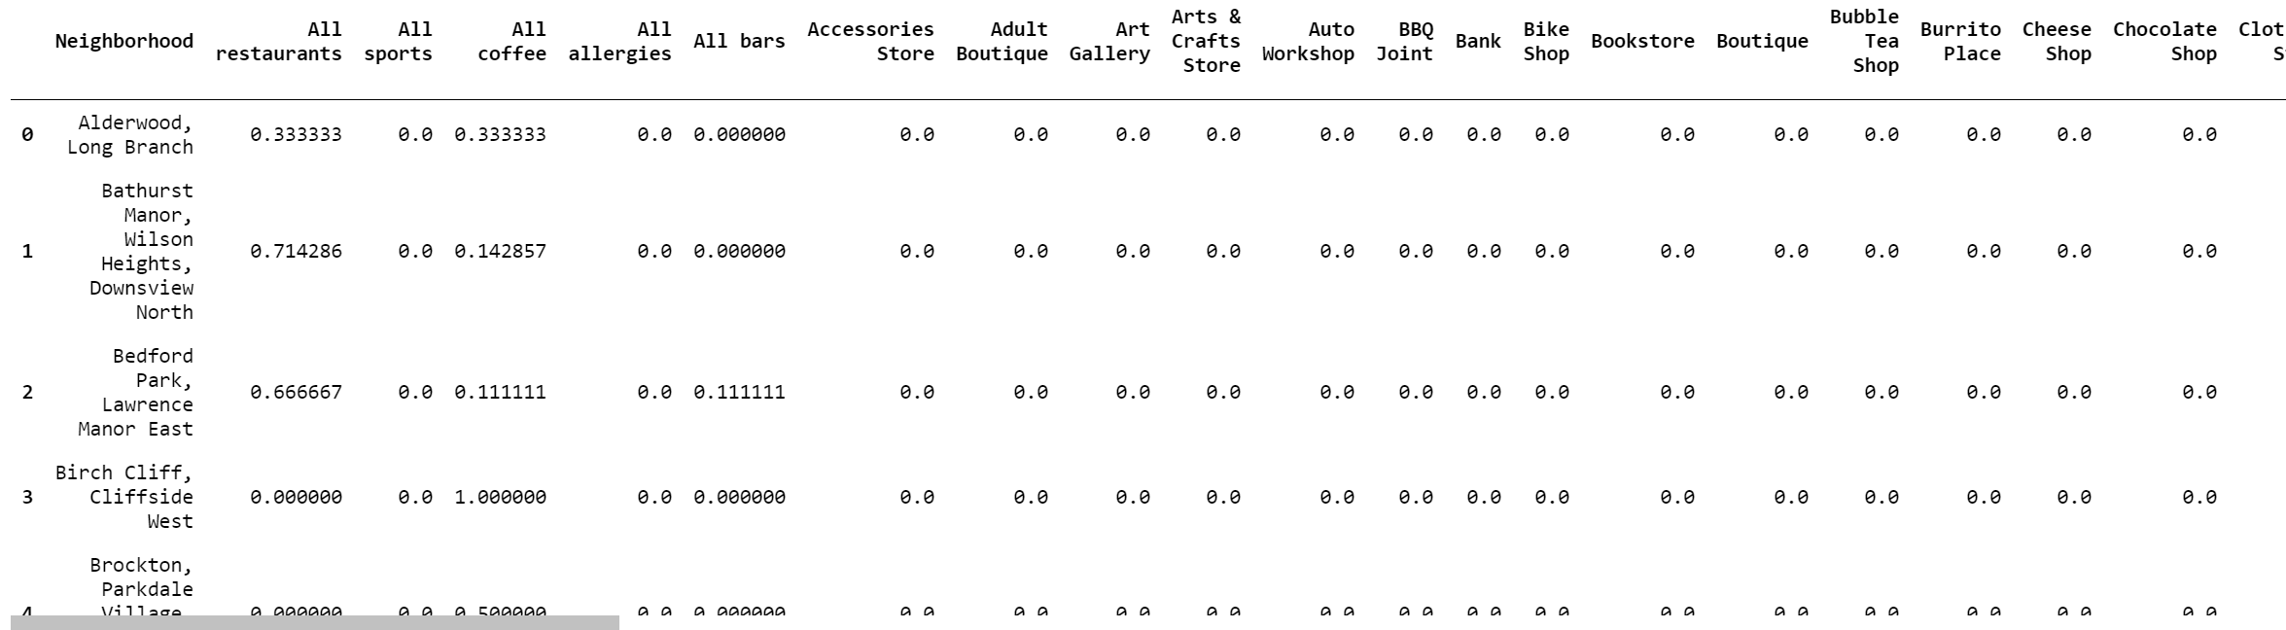
Clean up data
Retrieve location data from Foursquare
Categorized the shops into bigger categories

Slide 8
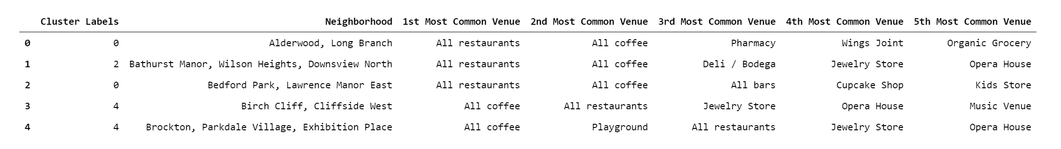
Perform analysis, clustering, and visualization
K-means clustering performed
Sorted the dataframe with the top 5 venues

Slide 9
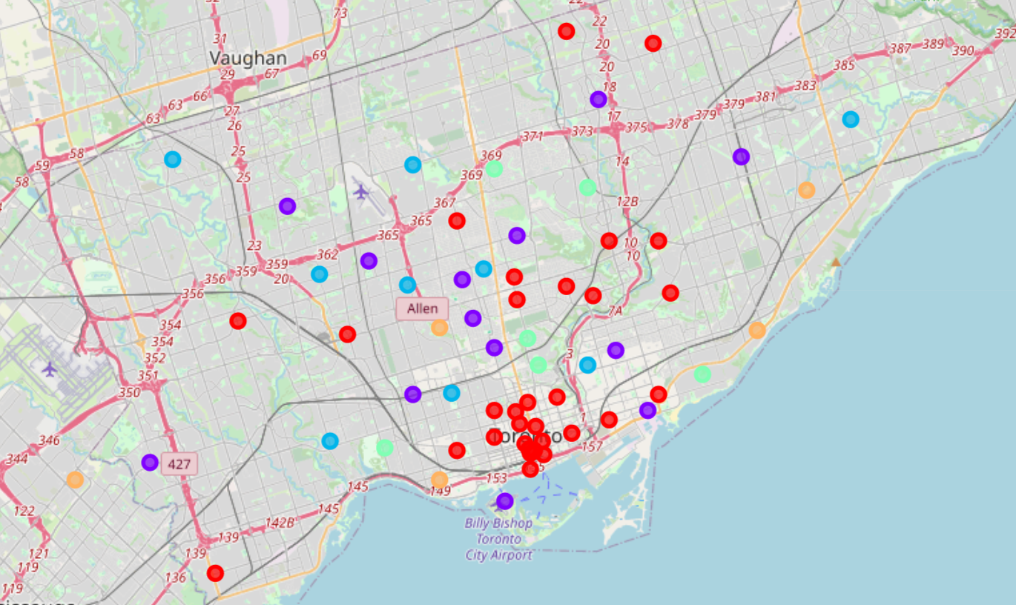
Perform analysis, clustering, and visualization
The distribution of all the clustered neighborhoods differentiated by color

Slide 10
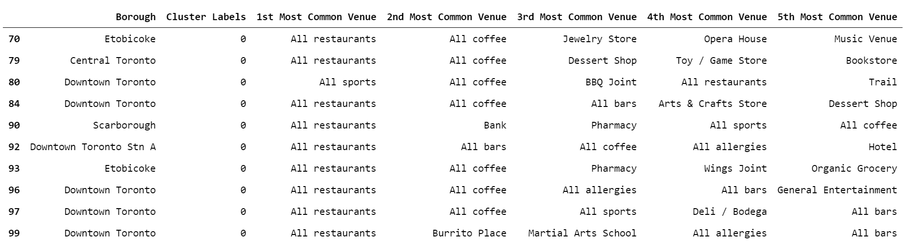
Results
We narrow down from 100 neighborhoods to around 30, based on the requirement of the client

Slide 11
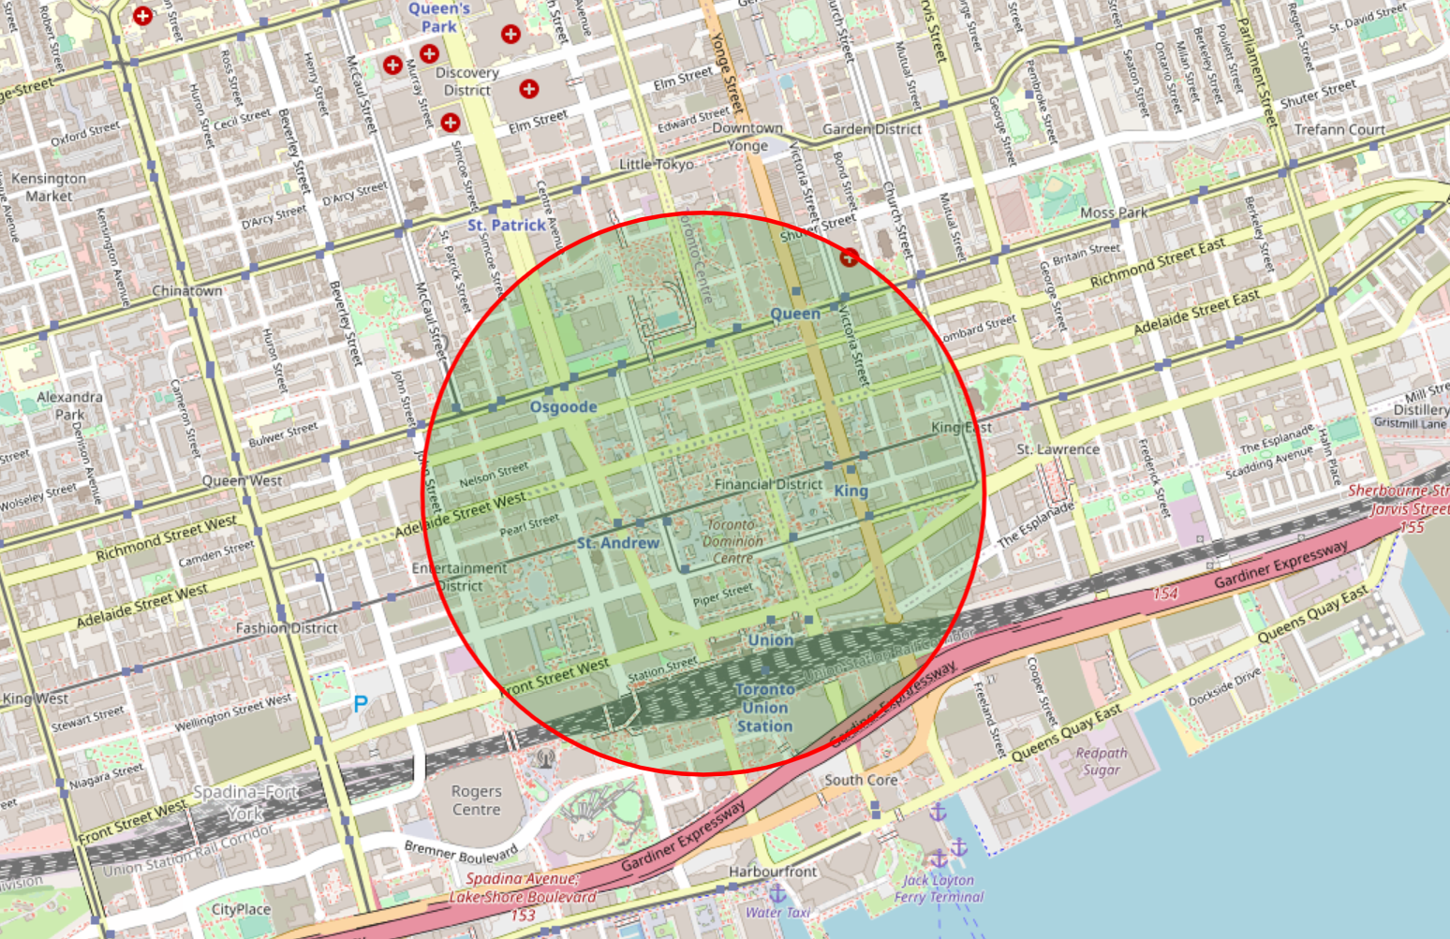
Results
The neighborhood with postal code “M5X” should be the suitable choice and is shown on the map

Slide 12
Discussion and Conclusion
The criteria for getting the end results in this project
Top common venue: the restaurants
2nd and 3rd common venue: coffee shops and sports related facilities
Exclusion criteria: venues that could cause allergy
The most suitable neighborhoods for David to live in Toronto
First Canadian Place or
Underground city, which are both inside Downtown Toronto.

Slide 13
Future work
A more thorough investigation of the price of apartments located in these two neighborhoods should be conducted
Further information required from the client
Size of the apartment
Room numbers
Interior design
And more…

